Slide 1

Batch : 2020 – 2024
Project Review

Slide 2
Candidate Details:
 | Candidate I: | Candidate II:
Name: | SAI VIKRAM KARTHIKEYAN | SANJAY GANESH . M
Register number: | 312320104119 | 312320104123
Guided by: | Ms. T. Jenitha ME, Assistant Professor Department of Computer Science and Engineering
Domain | Machine learning , Deep learning
Proposed Title: | Sign language recognition system

Slide 3
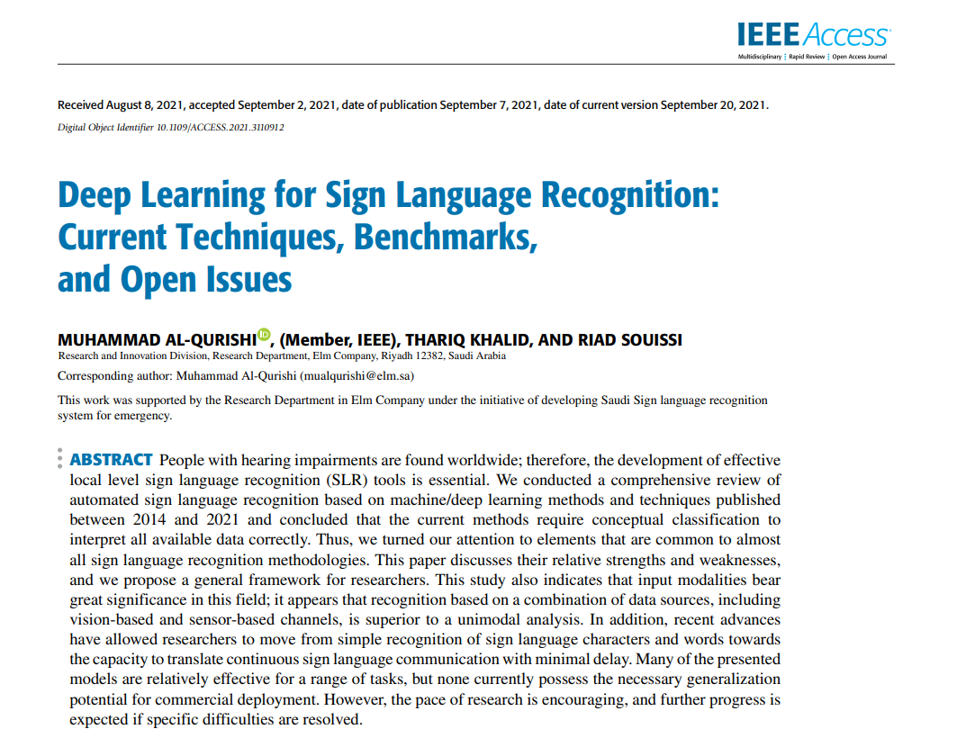
Base Paper:
TITLE:
Deep learning for sign language recognition: Current Techniques, Benchmarks, and open Issues
Authors: MUHAMMAD AL-QURISHI , (Member, IEEE), THARIQ KHALID, AND RIAD SOUISSIPublication: IEEE Access 2021

Slide 4
Proposed title:
Sign language recognition system
Base paper title:
Deep learning for sign language recognition: Current Techniques, Benchmarks, and open Issues.

Slide 5
Abstract:
We know that basic education and literacy are essential for reducing poverty, improving health, encouraging community and economic development, and promoting peace. If all women completed primary education, there would be 66% fewer maternal deaths. A child born to a mother who can read is 50% more likely to survive past the age of five. If all students in all countries left school with basic reading skills, 171 million people could be lifted out of poverty, which would be equivalent to a 12% cut in world poverty but there are also students who are deaf and dumb.so many factors will have great impacts for deaf and dumb people and that is why this project helps in promoting digital literacy for those people but not only for that , it can greatly help in conversing between a specially impaired people and normal people . We view this project as a case which can support the hearing impaired people in their day to day life. Communication shouldn’t be barrier between people as it should be accessible to the specially impaired people (that is deaf and dumb people in our case) as similar to everyone and also it can help in schooling systems to teach those specially impaired people to understand and converse with everyone seamlessly that is the goal of our project.

Slide 6
Project scope:
Resizing static ASL binary images with bicubic interpolation.
Successful detection of hand boundaries using the Robert edge detection method
Employing Convolutional Neural Networks and Deep Learning to classify the 26 static ASL alphabet characters .
Achieving rapid training with outstanding accuracy at 97.3%.
Project Objective:
Normal individuals often struggle to comprehend the hand signs used by speech-impaired people.
Sign language is primarily used by the deaf and those with speech impairments
Sign language is not commonly understood by hearing individuals, creating
communication gap.

Slide 7
Literature Survey (1):
Paper details | Concepts/ Findings / Observations Technique/ Idea used | Pros and Cons
Hummadi FN, Al-Nuaimy(2021)- Deaf and mute people interaction | Design and implementation of deaf and mute interaction system | To the digital content creation and safety that currently lack assessment.

Slide 8
Literature Survey (2):
Paper details | Concepts/ Findings / Observations Technique/ Idea used | Pros and Cons
Kumar S, Yadav G, Singh HP, Malhotra S, Gupta A(2019) - SSVM classifier and hand gesture based sign language recognition. | SSVM classifier for normal, deaf and dumb and blind people based on machine learning. | Hand gestures can help in communication and drafting purposes

Slide 9
Literature Survey (3):
Paper details | Concepts/ Findings / Observations Technique/ Idea used | Pros and Cons
. Tao W, Leu MC,Yin Z(2019) - ASL alphabets recognition | ASL alphabet recognition using conventional neural networks with multi view augmentation and interference fusion | This technology can help in the recognition of signs using neural network

Slide 10
Literature Survey (4):
Paper details | Concepts/ Findings / Observations Technique/ Idea used | Pros and Cons
Nath GG, Anu VS(2019)- Embedded sign language interpreter system | Embedded sign language interpreter system for deaf and dumb people | the ability to "read" visual messages embedded in graphic user interfaces

Slide 11
Literature Survey (5):
Paper details | Concepts/ Findings / Observations Technique/ Idea used | Pros and Cons
Basonbul, N.A.S(2023) - Shifting to D-learning during crises | Deaf students need sign language interpreters along with the teacher because it’s difficult to explain it in sign language with limited engagement | This can improve in the way of understanding for deaf and dumb students

Slide 12
Literature Survey (6):
Paper details | Concepts/ Findings / Observations Technique/ Idea used | Pros and Cons
Sanaullah, Muhammad, et al (2022)-A real-time automatic translation of text to sign language | This architecture for an application named Sign4PSL that translates the sentences to Pakistan Sign Language (PSL) for deaf people | The results have shown that the students were able to understand the words clearly

Slide 13
Literature Survey (7):
Paper details | Concepts/ Findings / Observations Technique/ Idea used | Pros and Cons
Patel U, Ambekar AG(2019)-Moments of human SLT | Moment based signs language recognition for Indian language | The “digital content creation” and “safety” that currently lack assessment

Slide 14
Literature Survey (8):
Paper details | Concepts/ Findings / Observations Technique/ Idea used | Pros and Cons
Berge, Sigrid Slettebakk(2023) - A shared responsibility for inclusion of sign interpreting in schools | The main purpose of this study was to examine the perception of teachers of students with hearing impairment (SWHI) about the factors affecting them . | It can help the visually impaired unterstand the things through sign language

Slide 15
Existing system
Deaf students need sign language interpreters along with the teacher because it’s difficult to explain it in sign language with limited engagement.
Moment based signs language recognition for Indian language.
ASL alphabet recognition using Recurrent neural networks with multi view augmentation and interference fusion
This architecture for an application named Sign4PSL that translates the sentences to Pakistan Sign Language (PSL) for deaf people

Slide 16
Disadvantages of the existing system:
Limited Accuracy: Existing systems may suffer from limited accuracy in recognizing and interpreting sign language gestures, leading to misinterpretations and communication errors.
High Costs High-quality sign language recognition systems can be costly to develop and maintain, making them less accessible for smaller organizations or individuals
User-Friendly Interfaces: Existing systems may lack user-friendly interfaces, making them challenging for non-experts to set up and use.
Real-time Processing :In some cases, existing systems may struggle with real-time processing, leading to delays in communication

Slide 17
Proposed system:
Image Capture: The system utilizes camera capture to record a sequence of images, capturing the signs made by the user.
Image Comparison: Each captured image is compared with a pre-built dataset of sign images to identify the sign being made by the user.
Sign Identification: The system uses image analysis techniques to identify the sign from the dataset, and the appropriate output is generated based on this identification
Feature Extraction: The system performs feature extraction by determining the position of the user's hand and its orientation in the captured images

Slide 18
Advantages of Proposed system:
Accessibility: The system makes sign language more accessible for individuals who use it as their primary means of communication, allowing them to interact with technology and the digital world.
Real-time Communication: It enables real-time communication with sign language users, breaking down communication barriers between hearing and non-hearing individuals.
Automation: The system automates the process of sign language interpretation, reducing the need for human interpreters in various scenarios, such as customer service or educational settings.
Consistency: Unlike human interpreters, the system provides consistent and accurate interpretation of sign language, reducing potential misinterpretations or errors

Slide 19
System requirements
Hardware requirement: processor – Pentium iv and ,Ram – 8 GB and above
Hard disk – 100GB or above 500GB , Display – 1920 x 1080 Monitor
Software Requirement: Python , NumPy , IDE(PyCharm),Keras(version2.3.1), cv2(open cv)(version2.3.1), Tensor flow (Keras uses in tensor flow for image preprocessing(version2.2.0).

Slide 20
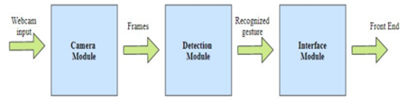
Architecture diagram:
Pic of architecture diagram

Slide 21
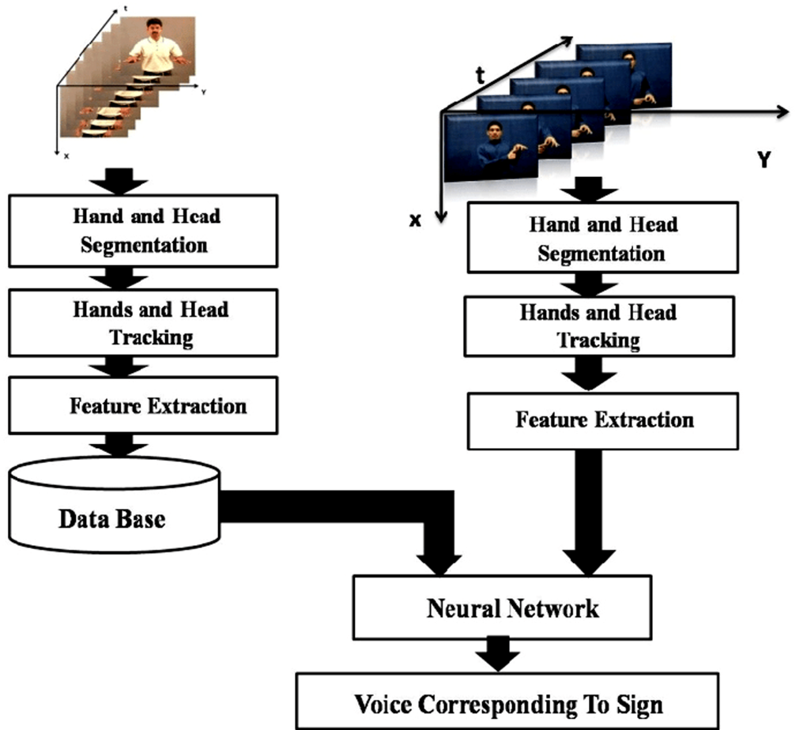
System flow:

Slide 22
Modules:
Dataset collection
Image detection
Feature extraction
Image recognition
Output

Slide 23
DATASET COLLECTION
In this step, a set of images for each letter in the sign language is fed to a database.
The number of images may vary from 100 to 200, with different angles of each particular gesture included.
The input obtained is then compared with the given images in the dataset to identify the gesture made.
The reason for the number of images in the dataset is to get the output with a good amount of accuracy and also to avoid ambiguity, which has high chances of occurring in sign language as one gesture might be similar to another one.
Thus, the dataset can be considered as the fundamental need in supervised type of machine learning..

Slide 24
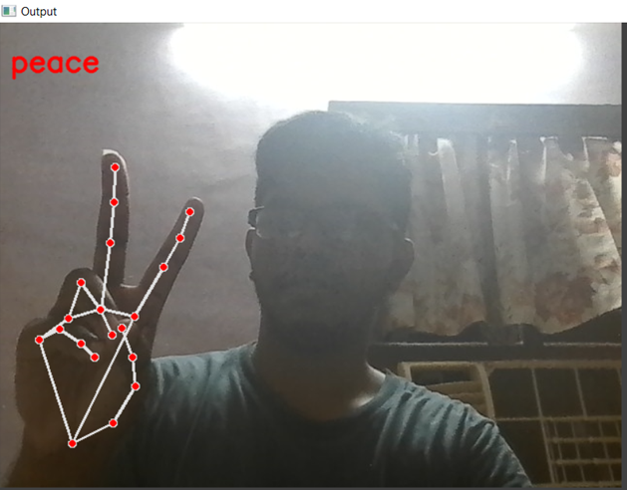
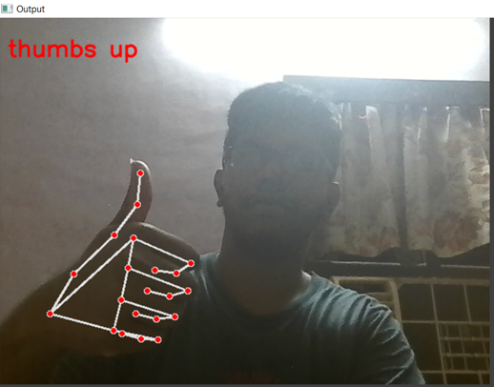
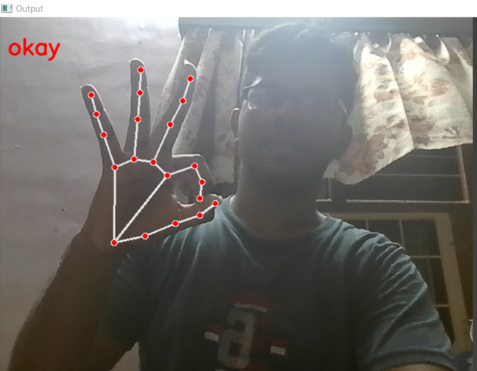
Sample output:
PEACE THUMBS UP OKAY

Slide 25
IMAGE DETECTION
This is the step that comes right after camera capture. Image detection refers to detecting the image that is obtained and, in this case, it is found out if the obtained image is that of a hand or not.
A binary classifier is to be trained beforehand to check the same.
A binary classifier has the task of classifying sets into two groups, depending on the criteria the sets meet.
It checks for one or more qualities that a particular set should possess.
It is according to that factor that a binary classifier decided to which group the set should be sent to.

Slide 26
Feature extraction
Feature extraction refers to extracting the details from the image captured. In a sign language interpreter, the image captured is a gesture made by a hand.
Therefore, the features extracted from such images include the size of the palm, the number of fingers open, etc.
These features are then used to recognize the gesture using certain algorithms

Slide 27
Image Recognition
Image recognition is the most crucial procedure of this project. The acquired image is converted to its vector form.
The model used is SVM, support vector machine. Support Vector Machine is used to analyze data and classify them.
Support Vector Machine comes under supervised machine learning.
SVM represents the examples as points in space that are mapped so that they are separated according to the category they come under.

Slide 28
Output
Two of these modules contribute to the successful working of sign language interpreting system.
The flow of execution takes place in the following manner: The camera gets the input gesture image from the user, the detection process takes place to check if it is a hand or not using certain algorithms, image recognition is the next step .
where the image acquired from the user is compared with the images in the dataset, to interpret the shown gesture.
Image recognition is done using a model known as SVM or Support Vector Machine.
The next step is the output where the recognized symbol is converted to text form as the output.

Slide 29
Reference:
[1]Herzig, Melissa, and Thomas E. Allen. "Deaf children’s engagement with American Sign Language-English bilingual storybook apps." The Journal of Deaf Studies and Deaf Education 28.1 (2023): 53-67.
[2]Alawajee, Omar. "Exploring the sign language proficiency of university undergraduate students in a pre services preparation program for teachers of deaf students." Higher Education Pedagogies 7.1 (2022): 65-87.
[3]Ott, Laura E., Linda C. Hodges, and William R. La Course. "Supporting deaf students in undergraduate research experiences: Perspectives of American Sign Language interpreters." Journal of Microbiology & Biology Education 21.1 (2020): 20.
[4]Reagan, Timothy, Paula E. Matlins, and C. David Pie lick. "Deaf Epistemology, Sign Language and the Education of d/Deaf Children." Educational Studies 57.1 (2021): 37-57.
[5]Hussein, Karim Q., and Maha A. Al-Bayati. "Multi-Mode e-Learning System of Reading Skills for Deaf Students Based on Visual Multimedia." International Journal of Interactive Mobile Technologies 16.10 (2022).

Slide 30
Reference
[6] A. Sabyrov, M. Mukushev, and V. Kimmelman, Towards real-time sign language interpreting robot: Evaluation of non- manual components on recognition accuracy, in Proc. CVPR Workshops, 2019, pp. 7582.
[7]S. Islam, S. S. S. Mousumi, A. S. A. Rabby, S. A. Hossain, and S. Abujar , A potent model to recognize Bangla sign language digits using con volutional neural network, Proc. Comput. Sci., vol. 143, pp. 611618, Jan. 2018.
[8]R.-H. Liang and M. Ouhyoung, A sign language recognition system using hidden Markov model and context sensitive search, in Proc. ACM Symp. Virtual Reality Softw. Technol. (VRST), 1996, pp. 5966.
[9]B. Saunders, N. C. Camgoz, and R. Bowden, Continuous 3D multi channel sign language production via progressive transformers and mixture density networks, Int. J. Comput. Vis., vol. 2021, pp. 123, May 2021.

Slide 31
thank you

